Slide 1
NAME: Amaya. N
UST EMAIL: 214381@ust-global.com

Slide 2
CONTENTS
Storage Account with 4 containers
File Share with 2 Containers
Message Queue with a Message
Table
Sample Database with Query
To estimate unit sales of retail goods
Financial need programs for Consumer Loan Products

Slide 3
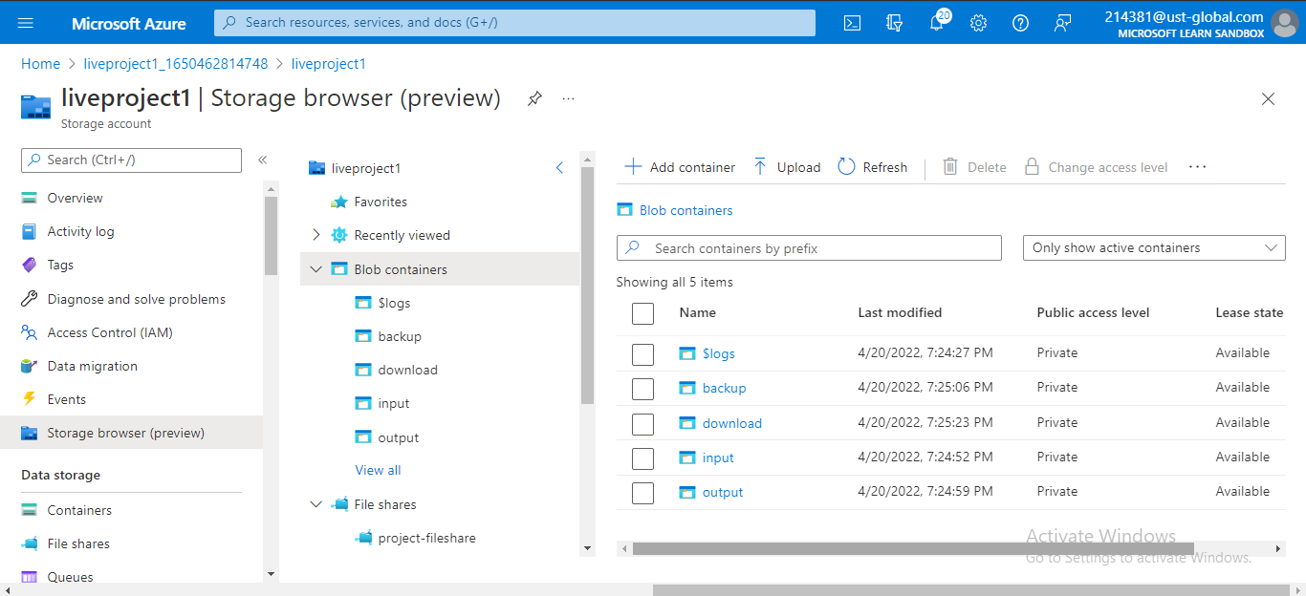
Storage Account with 4 containers:

Slide 4
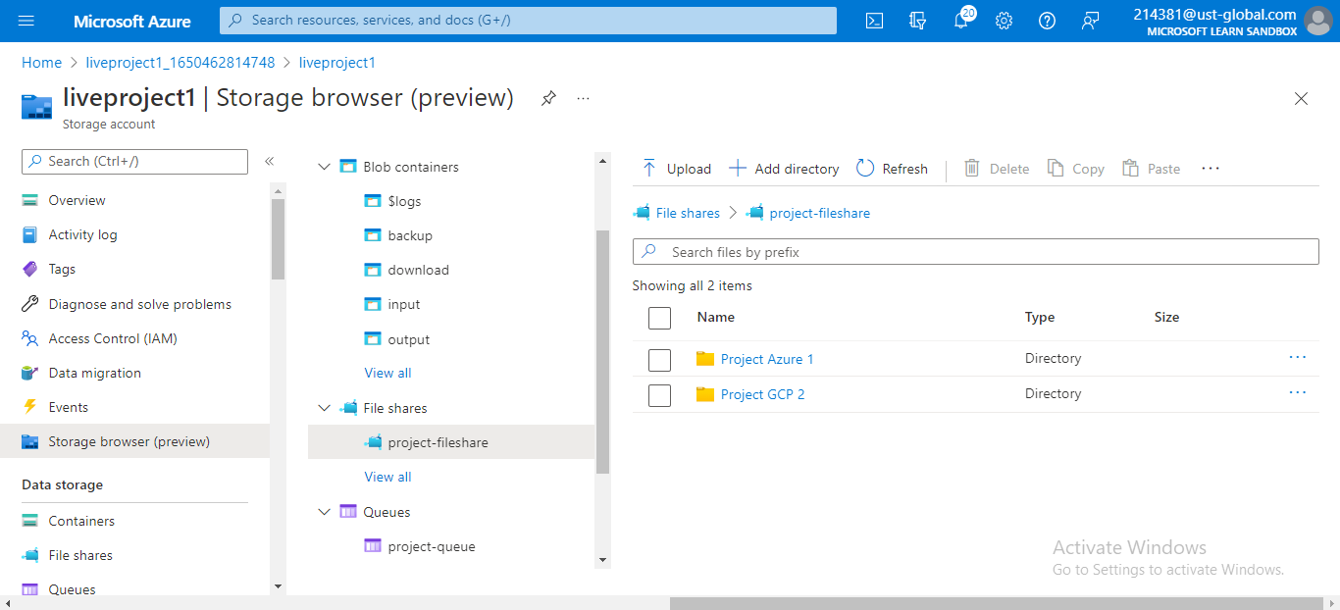
File Share with 2 Containers:

Slide 5
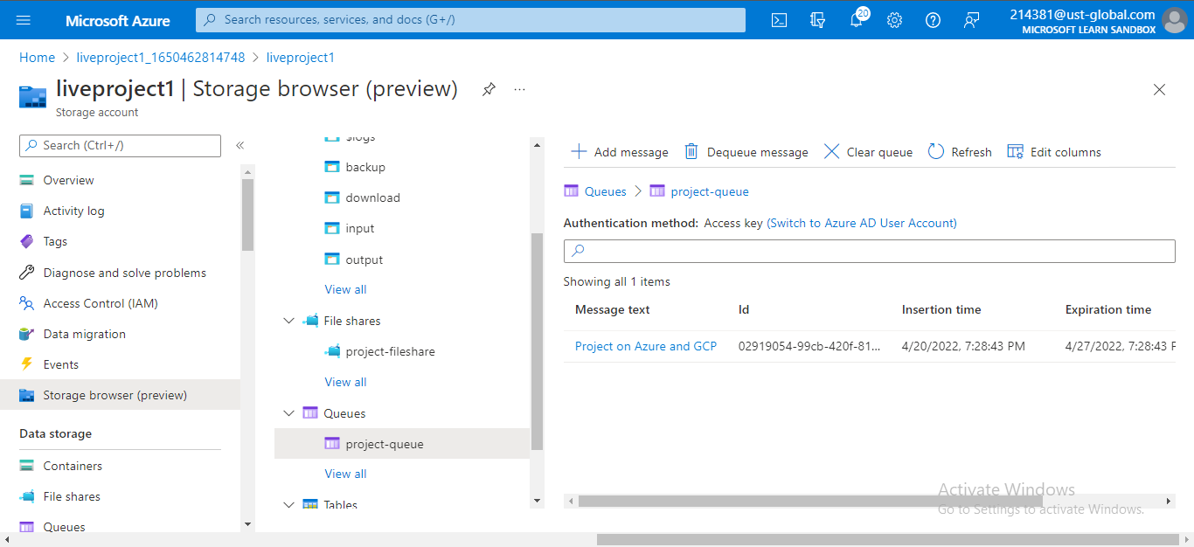
Message Queue with a Message:

Slide 6
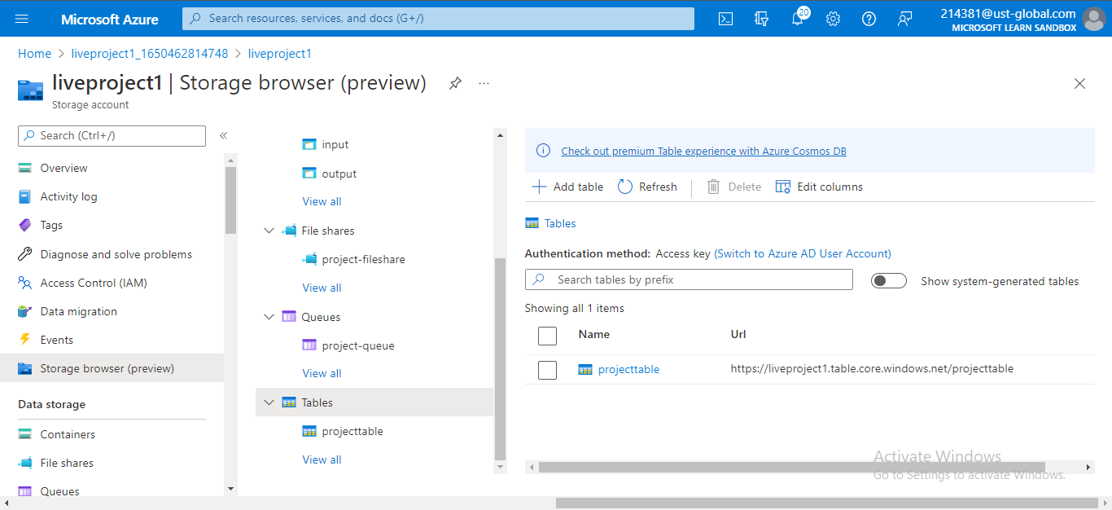
Table:

Slide 7
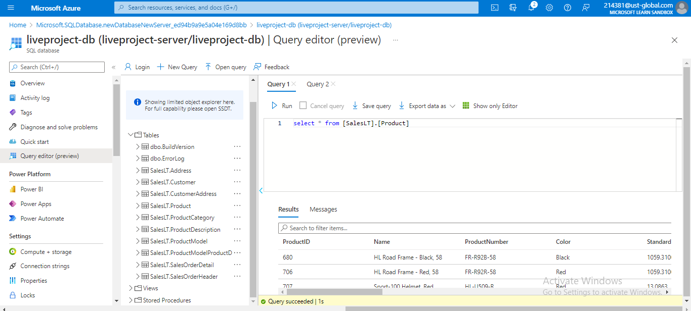
Sample Database with Query:

Slide 8
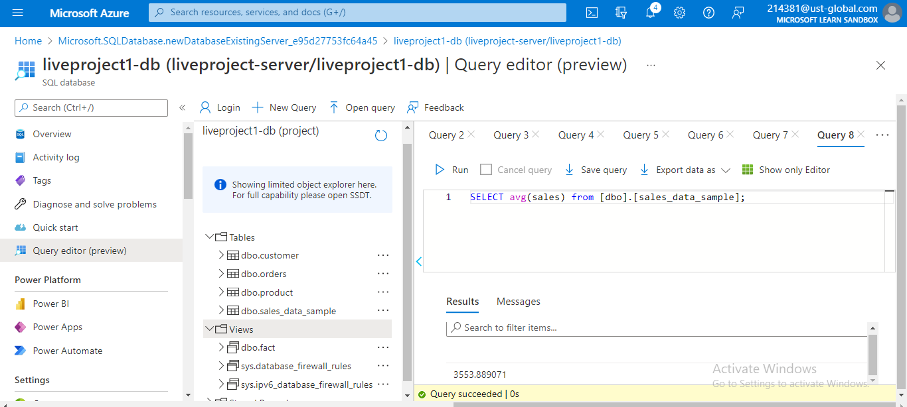
To estimate unit sales of retail goods:

Slide 9
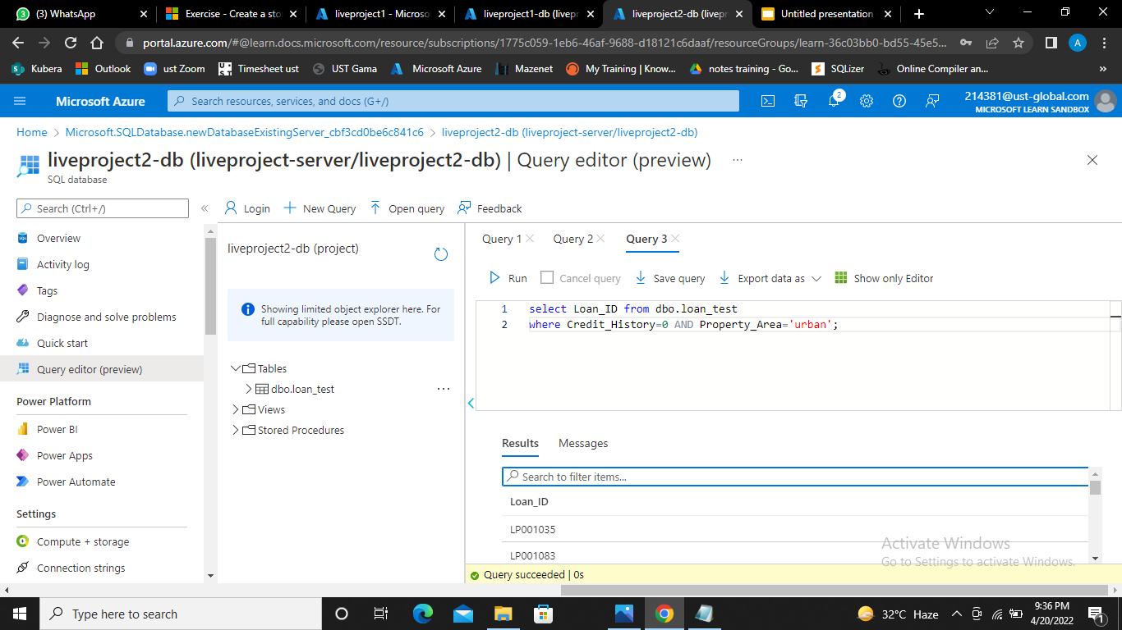
Financial need programs for Consumer Loan Products:

